Slide 1




Basics of MongoDB
A clear, hands-on introduction to modern NoSQL databases, JSON document modeling, and essential query commands for new developers.

Slide 2



Frontend Web Storage vs DB
Frontend Local Storage (Web)
Backend Database (MongoDB)
Native browser storage APIs for temporary or device-local state.
Centralized, persistent database engine powering entire web systems.
→
localStorage: Stores string key-value pairs persistently (~5MB capacity) until cleared.
→
Permanent Persistence: Saves records directly to server disk; unaffected by browser refreshes.
→
sessionStorage: Volatile storage that automatically purges when the browser tab closes.
→
Universal Access: Accessible across multiple devices, platforms, and concurrent users.
→
Ideal Uses: UI themes (Dark/Light mode), JWT auth tokens, user draft inputs.
→
Massive Scale: Manages millions of JSON-like BSON documents with indexing & fast lookups.
→
Limits: Bound to a single browser device; no server-wide syncing or complex querying.
→
Security: Safely hidden behind authentication APIs, role gates, and backend validations.

Slide 3

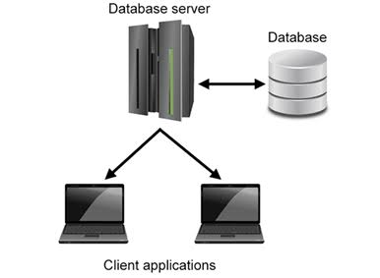
MongoDB in the MERN Stack
The M in MERN: MongoDB represents the database tier in the full-stack MERN stack (MongoDB, Express, React.js, Node.js).
Permanent Storage: Databases persist application data safely on disk, retaining records even when web servers restart.
Dynamic vs Defined: Traditional SQL requires strictly defined schemas, whereas NoSQL accommodates dynamic and evolving data structures.
EX: FB
Drivers & ODM: Mongoose serves as the official Object Data Modeling (ODM) driver for connecting Node.js with MongoDB collections.

Slide 4

Database Storage & Schemas
Relational Databases (SQL)
Non-Relational Databases (NoSQL)
Designed for persistent storage with predetermined and strictly enforced schemas.
Built for agile workflows, fluid structures, and high throughput data streams.
→
Organized strictly into tables, rows, and predefined columns.
→
Organized into flexible collections containing independent documents.
→
Ideal when data relationships and schema structures are fixed and defined upfront.
→
Used when application structure or incoming schema is unclear or evolving.
→
Requires schema migrations whenever adding or altering fields.
→
Documents can contain unique fields without affecting peer records.
→
Popular Industry Examples: MySQL, PostgreSQL, Oracle.
→
Popular Industry Examples: MongoDB, AWS DynamoDB.

Slide 5

What is MongoDB?
A Document-Oriented Engine
MongoDB is an open-source, distributed NoSQL database engine designed to store, query, and process modern application data at massive scale.
Instead of locking data into strict tabular constraints, it maps directly to native objects in languages like JavaScript, Python, and Java.

Slide 6




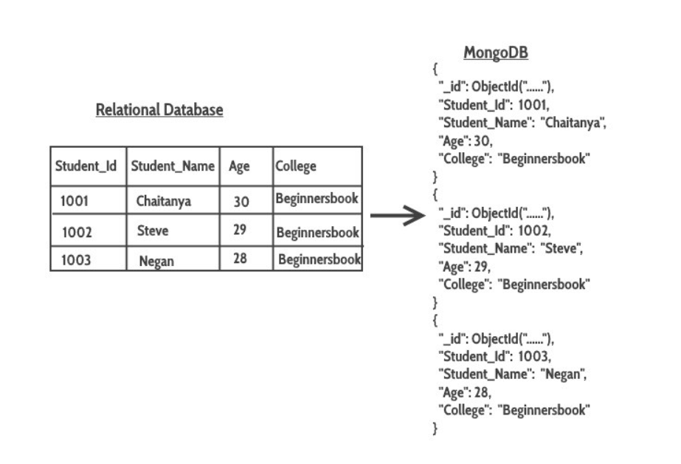
The Core Data Hierarchy
1. Database
2. Collection
3. Document
The top-level container holding all related collections. A single MongoDB cluster can host dozens of isolated databases for separate projects.
A named group of MongoDB documents, analogous to a table in SQL. Collections do not enforce a rigid universal schema across all their records.
The individual data record consisting of field-and-value pairs. Stored natively in BSON format with a guaranteed unique _id identifier.

Slide 7

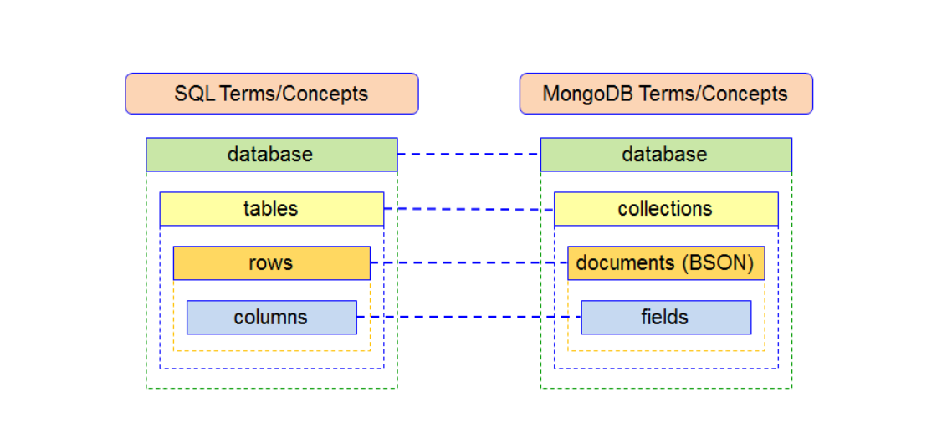
SQL to MongoDB Terminology
Relational Database (SQL) | MongoDB (NoSQL) | Core Conceptual Role
Database | Database | Container for organizational schemas and storage.
Table | Collection | Group of related entity records sharing domain logic.
Row / Record | Document | Single item entry stored as key-value pairs.
Column | Field | Specific data attribute name inside an entry.
Primary Key (PK) | _id (ObjectId) | Guaranteed unique index identifying the record.
JOIN Query | $lookup / Embedded Docs | Associating data between related business concepts.

Slide 8
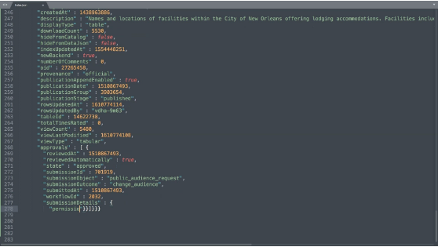
Understanding JSON and BSON
JSON (JavaScript Object Notation): Human-readable text format widely used for web APIs and client-server transmission.
BSON (Binary JSON): The internal binary-encoded serialization format MongoDB uses on disk and over the wire.
Performance Optimized: BSON enables rapid scanning and indexing by prefixing fields with explicit byte lengths.
Extended Data Types: Supports types JSON lacks, including Date, Int32, Int64, and binary ObjectId.

Slide 9

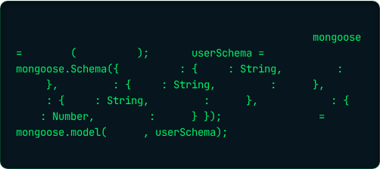
Mongoose ODM & Schemas
What is Mongoose?
Example User Schema
A Node.js driver and Object Data Modeling (ODM) library that brings structure when needed.
Defining document attributes and expected data types in code:
→
Acts as a bridge connecting your Node/Express backend to MongoDB.
// Example Mongoose Schema for User entity
const
→
Allows developers to define strict schemas and validation rules in code.
require
'mongoose'
const
new
firstName
type
required
→
Translates JavaScript objects into persisted MongoDB documents automatically.
true
lastName
type
required
true
email
type
required
true
phoneNumber
→
Supports built-in data type casting, middleware hooks, and custom methods.
type
required
true
module.exports
'User'

Slide 10
Essential Developer Tooling
mongosh
MongoDB Compass
MongoDB Atlas
The official interactive JavaScript command-line interface. Used by developers to inspect collections, test queries, and run database administrative tasks.
The interactive GUI desktop client. Explore visual schemas, analyze query performance, build aggregation pipelines, and manage indexes with zero code.
Fully managed multi-cloud database service. Offers a free shared cluster tier (M0) that deploys in seconds across AWS, Google Cloud, or Azure.

Slide 11
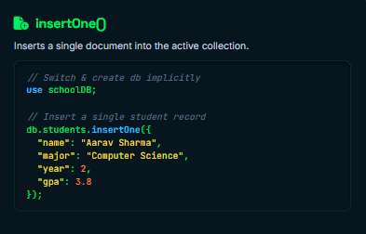
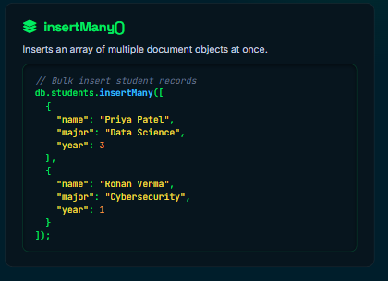
CRUD: Create Operations

Slide 12
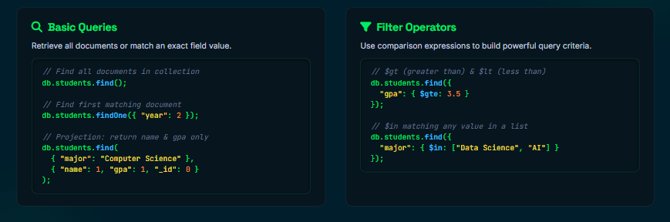
CRUD: Read Operations

Slide 13
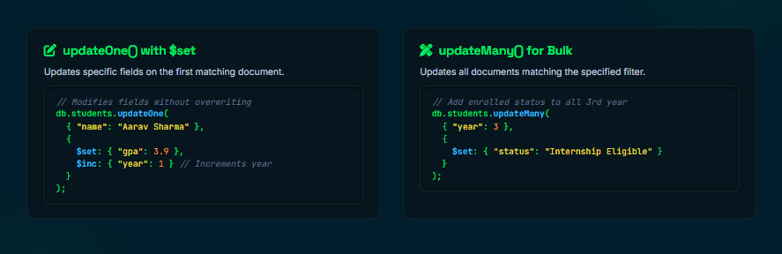
CRUD: Update Operations

Slide 14
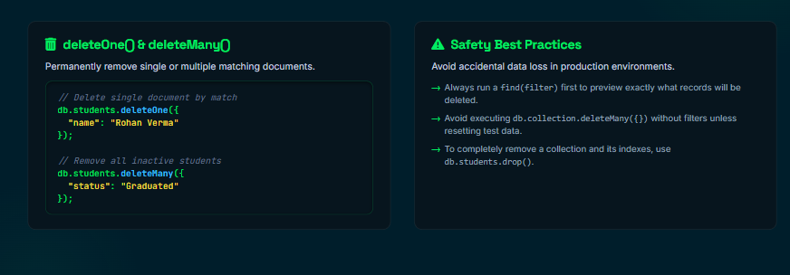
CRUD: Delete Operations

Slide 15

Ready for Hands-on Code?
Open your terminals, fire up mongosh or MongoDB Compass, and try creating your own school or store database today!
Challenge 1
Challenge 2
Challenge 3
Create a users collection and insert a user with firstName, lastName, and email.
Find all students with a GPA greater than 3.5 using the $gte operator.
Update a user document using the atomic $set and $inc operators.

